Slide 1

Traffic Flow Prediction IN URBAN CITIES
By:
P.Karthik rao
A.ROSHAN KUMAR

Slide 2
CONTENTS
Problem Statement
Introduction
Limitations
Prerequisities
Proposed System
Abstract
Literature survey
Gap Analysis
Conclusion
Algorithm
Future Scope

Slide 3
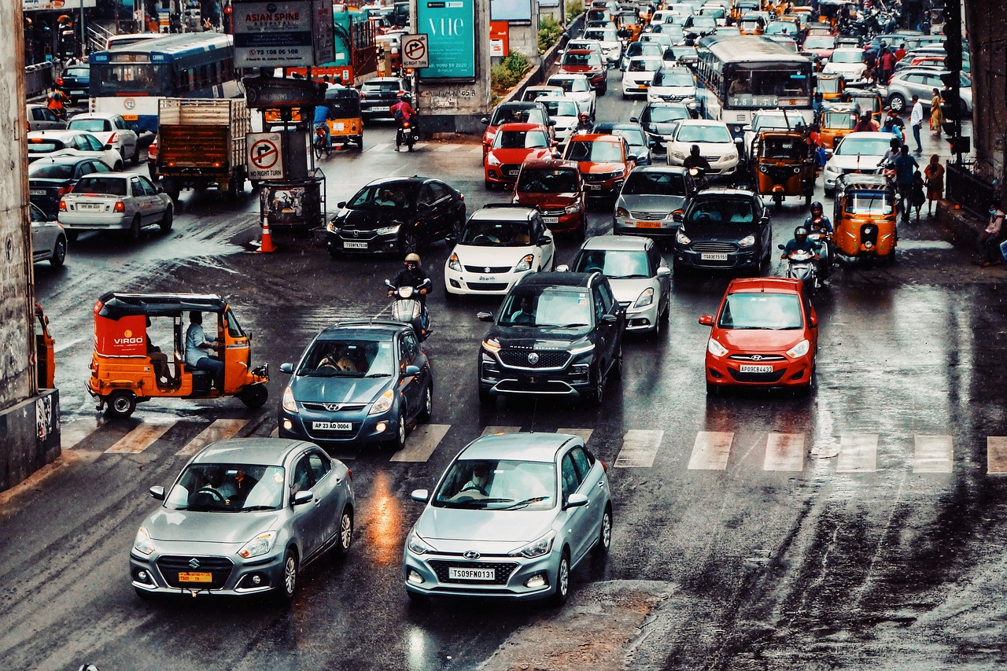

Abstract
This study aims to develop a traffic flow prediction system for urban cities, focusing on improving urban traffic management. The proposed system involves collecting historical traffic data from sensors and cameras, analyzing the existing traffic management systems, and developing a predictive model mining algorithm. The algorithm will optimize traffic signal timings and provide real-time recommendations to minimize congestion.. By implementing this innovative approach, smart cities can enhance their traffic efficiency and overall user experience.

Slide 4
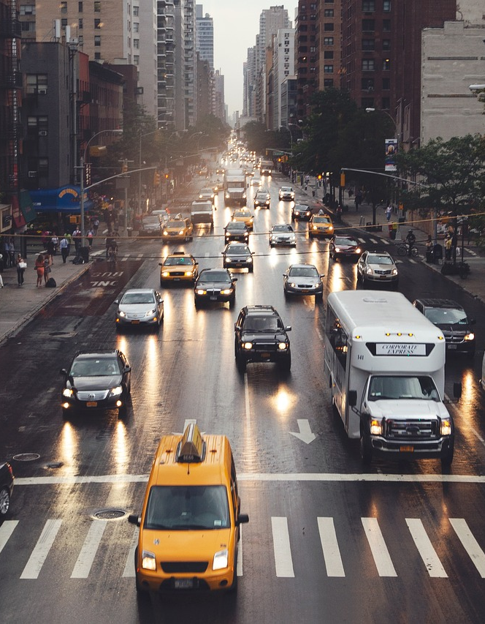
Introduction
In the context of rapidly growing smart cities, efficient traffic management has become crucial for ensuring smooth transportation and reducing congestion. With the increasing availability of real-time traffic data, this project seeks to leverage the power of data analytics and machine learning to create an intelligent traffic flow prediction system. By accurately forecasting traffic patterns, this system will enable city planners and transportation authorities to make informed decisions, ultimately improving the overall efficiency of urban transportation systems and the well-being of city dwellers.
Mirjam Nilsson​

Slide 5
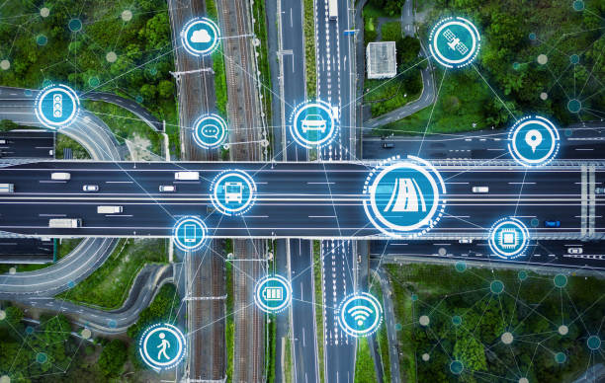

In current traffic management systems, there are several limitations that hinder their effectiveness in handling urban congestion. These include inaccurate prediction models, lack of real-time data integration, and insufficient consideration of various traffic classes. These shortcomings result in inefficient traffic flow, prolonged travel times, and increased environmental impact. To address these gaps, an advanced prediction model is needed to improve traffic flow management and reduce congestion in urban areas. Implementing such a system would lead to numerous benefits, such as reduced travel time, improved safety, and a more sustainable urban mobility plan. City planners and transportation authorities face challenges in addressing these gaps, including limited budgets, data privacy concerns, and the need for inter-agency coordination. The proposed system has the potential to not only fill these gaps but also contribute to the development of smart cities.
Gap
analysis

Slide 6
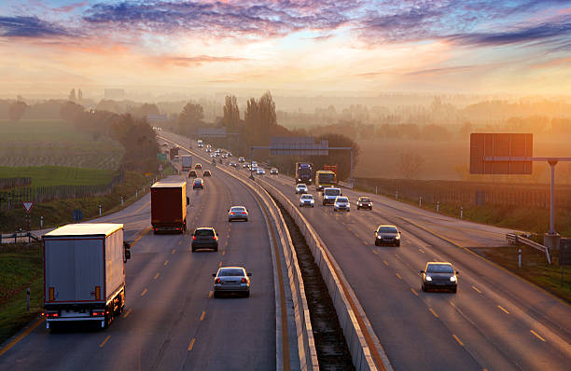
Proposed system
The advanced traffic prediction system addresses gaps in current traffic management by utilizing machine learning algorithms, real-time data integration, and smart city applications. It collects data from various sources, employs algorithms for accurate predictions, and features a user-friendly interface. The system is designed for continuous improvement and integrates with other smart city applications, promoting efficient urban mobility and sustainability. The system's key components and features are outline here. They are Data Collection and Integration,Machine Learning Algorithms,Real-time Data Processing,Data Preprocessing Techniques,User Interface and Visualization,Integration with Smart City Applications ,Continuous Improvement and Maintenance

Slide 7

Algorithm
The proposed system utilizes machine learning algorithms, such as neural networks and regression models, to analyze historical traffic data and predict future patterns. These algorithms take into account various factors, including time of day, day of the week, weather conditions, and special events, to provide accurate predictions. Continuous data collection and algorithm refinement are crucial to ensure the system's effectiveness and adaptability to changing traffic conditions. The algorithms' performance is evaluated using metrics like mean squared error and accuracy, ensuring reliability and precision. Additionally, the system incorporates real-time data from various sources, such as GPS devices, traffic sensors, and smartphones, to further enhance prediction accuracy. Data preprocessing techniques, such as normalization and feature selection, are employed to improve algorithm performance and reduce computational complexity.

Slide 8
.
Software Requirements
Python
MySQL
PHP, HTML & CSS
OpenCV
Scikit Learn
Prerequisities
Hardware Requirements
Memory Card
Laptop
Camera
8
.

Slide 9
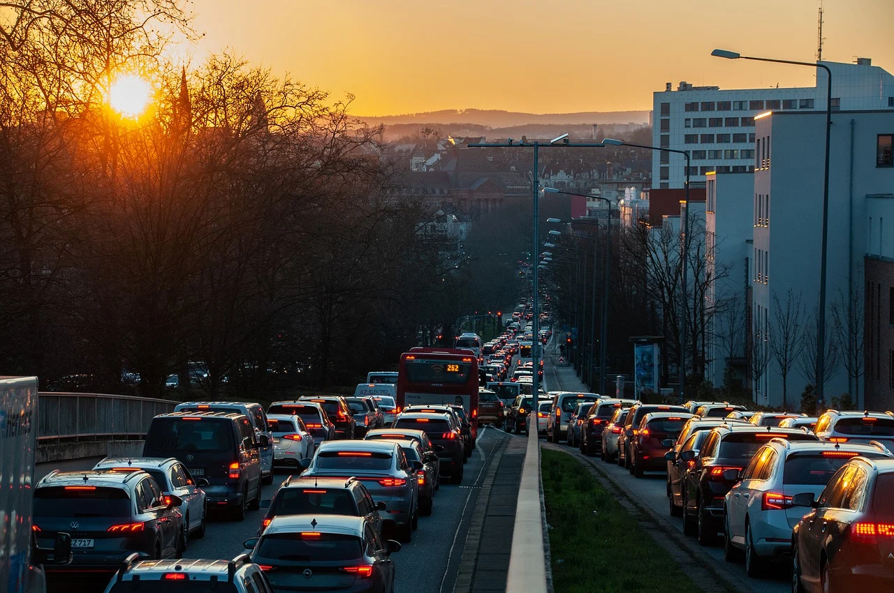
Limitations
One of the primary challenges in traffic flow prediction is the complexity of urban traffic systems, which involve numerous interconnected factors such as weather conditions, road infrastructure, and human behavior. Accurately capturing and processing real-time data from various sources, including vehicles, traffic signals, and public transportation, can be technically demanding. Additionally, ensuring data privacy and security while sharing information among different stakeholders is crucial for maintaining public trust.

Slide 10
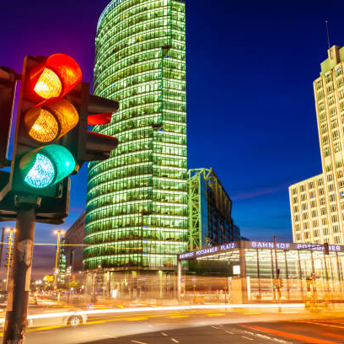
Future scope
Traffic flow prediction in smart cities offers immense potential for improving transportation efficiency, reducing congestion, and promoting sustainable urban development. Advancements in artificial intelligence, machine learning, and the Internet of Things (IoT) will play a crucial role in enhancing the accuracy and reliability of traffic flow predictions. Integration with smart traffic management systems and real-time data analysis can lead to proactive traffic control, optimized routes, and seamless connectivity between various modes of transportation

Slide 11
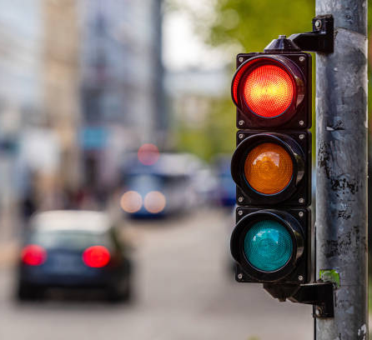
Conclusion
In conclusion, traffic flow prediction in smart cities holds great promise for revolutionizing urban transportation. By overcoming the current limitations and fostering collaboration among researchers, policymakers, and industry professionals, we can create smarter, more efficient, and environmentally sustainable cities. The successful implementation of these predictions will contribute to improved quality of life, reduced travel time, and enhanced overall urban experience for residents and visitors alike.

Slide 12
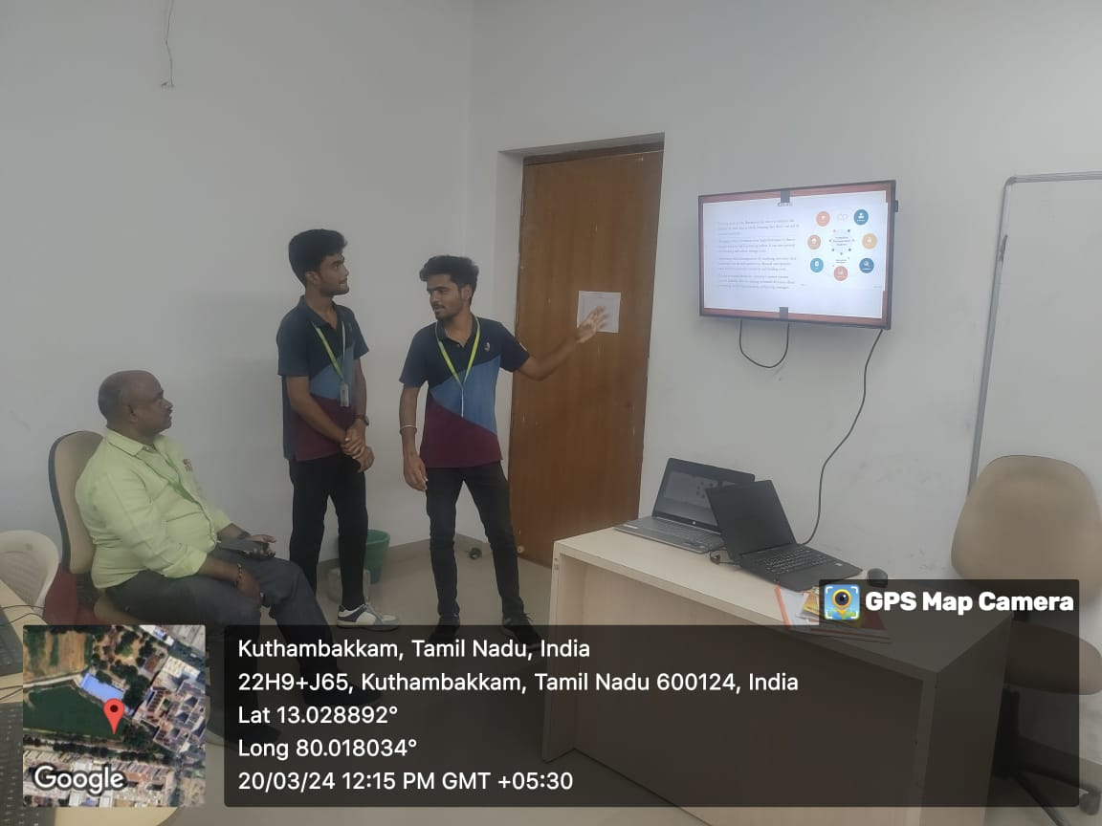

Slide 13

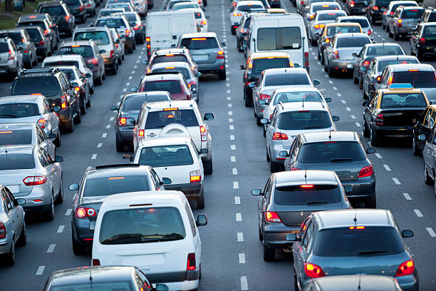
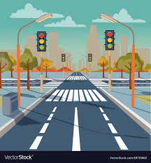
Thank you
BY :
P KARTHIK RAO
A ROSHAN KUMAR

